Slide 1
Python Programming Fundamentals
By: Digits

Slide 2
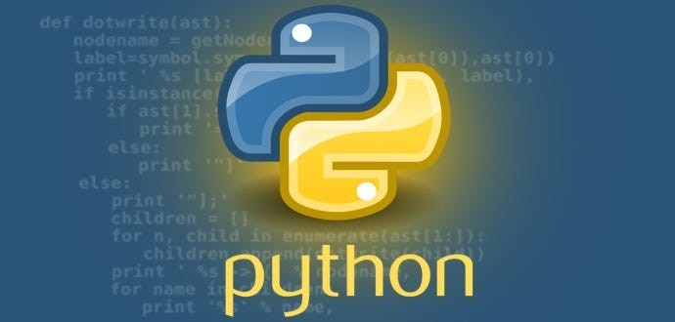
Introduction to Python
What is Python?
Python is a high-level interpreted programming language known for its simplicity and readability.
It is an open source and cross-platform programming language, that has become increasingly popular over a decade. It was first released in 1991.
Python is also a multi-purpose programming languages (due to its many extensions), examples are scientific computing and calculations, simulations, web development (using, e.g., the Django Web framework), etc.

Slide 3
Topics we will cover:
Python Applications
Arrays and Data Structures -> Lists, Tuples, Dictionaries
Loops (For loops, While loops, & Nested Loops)
Functions
Libraries (numpy, pandas, etc…)
Coding Conversions and Best Practices
Indentation
Naming Conventions
Case Sensitivity
Comments
Spacing
Python vs Other Languages

Slide 4
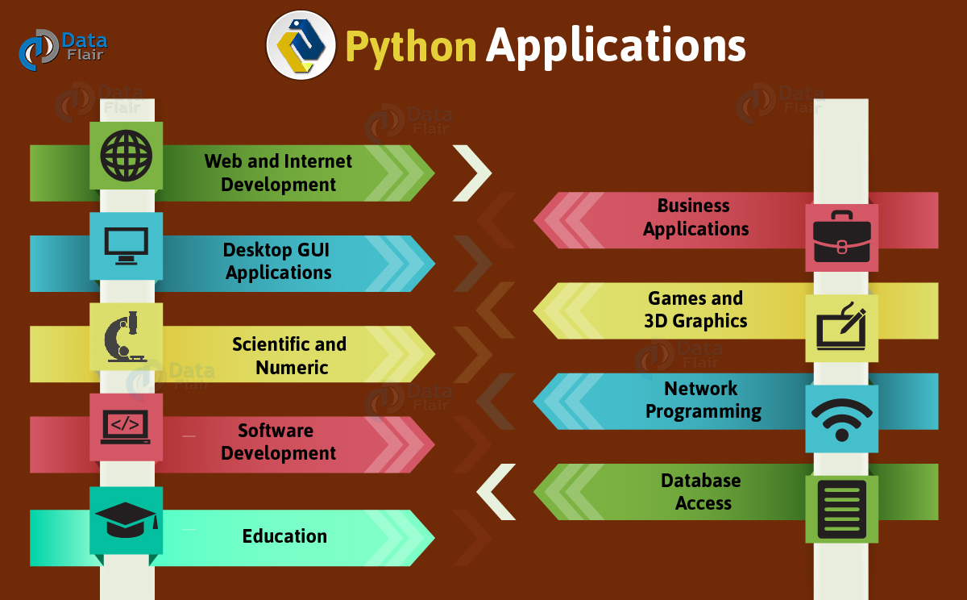
WHAT YOU CAN DO WITH PYTHON?

Slide 5
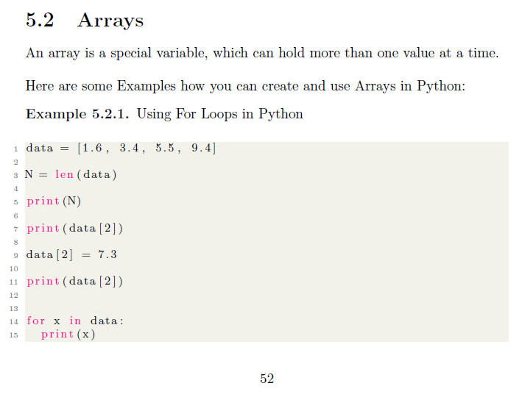
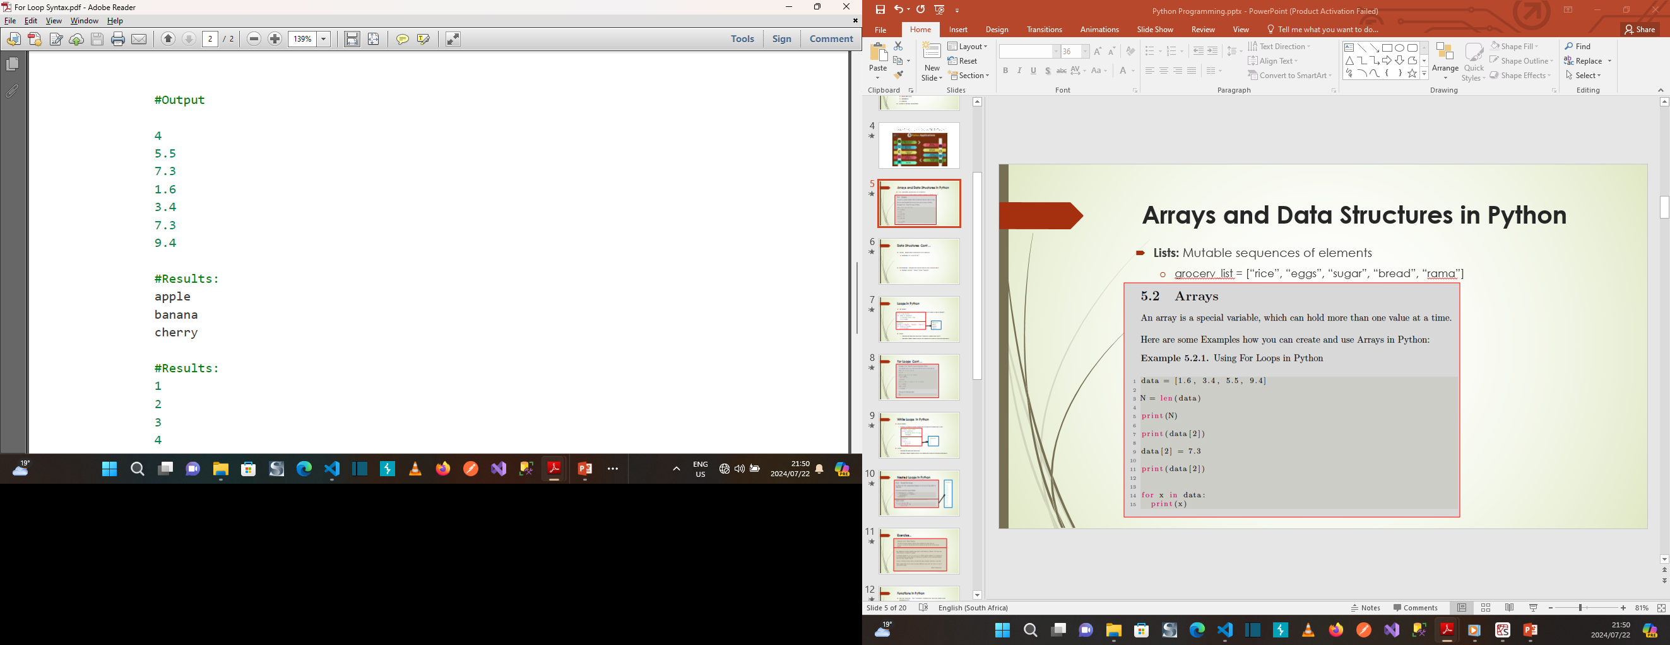
General Data Structures in Python
Linear Data Structures:
Arrays
Linked List
Stack
Queue
Matrix
Non-Linear Data Structures:
Binary Tree
Heap
Hash Table
Graph

Slide 6
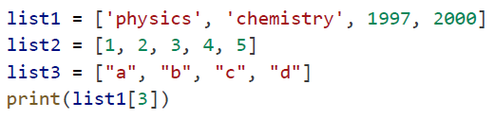
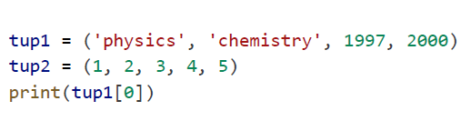
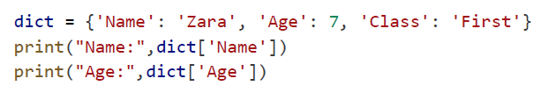
Python Specific Data Structures
List: is similar to array with exception, that the data elements can be of different data types. You can have both numeric and string data in a python list.
Tuples: are similar to lists, but they are immutable which means, the values in a tuple cannot be modified they can be read.
Dictionaries: are unordered collections of key-value pairs as its data elements
List Elements:
Access
Update
Delete
Values in Tuples:
Access
Delete
Dictionary Elements:
Access
Update
Delete
Properties of Dictionary Keys:
Dictionary values have no restriction.

Slide 7
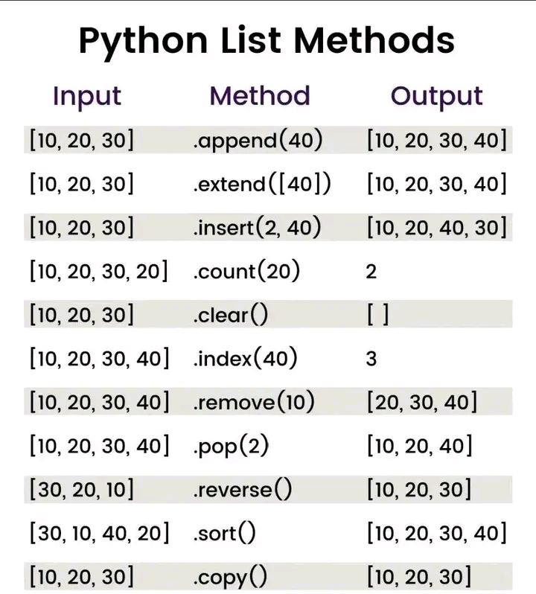
List methods…

Slide 8
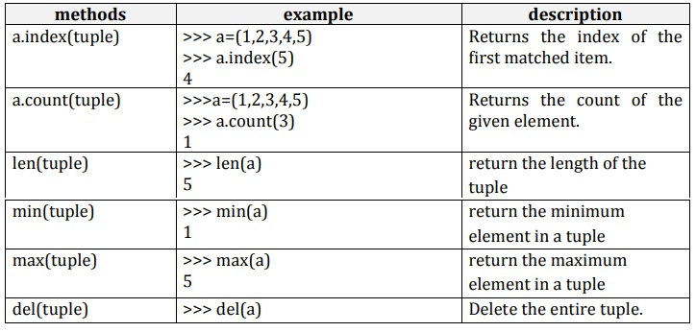
Tuple Methods

Slide 9
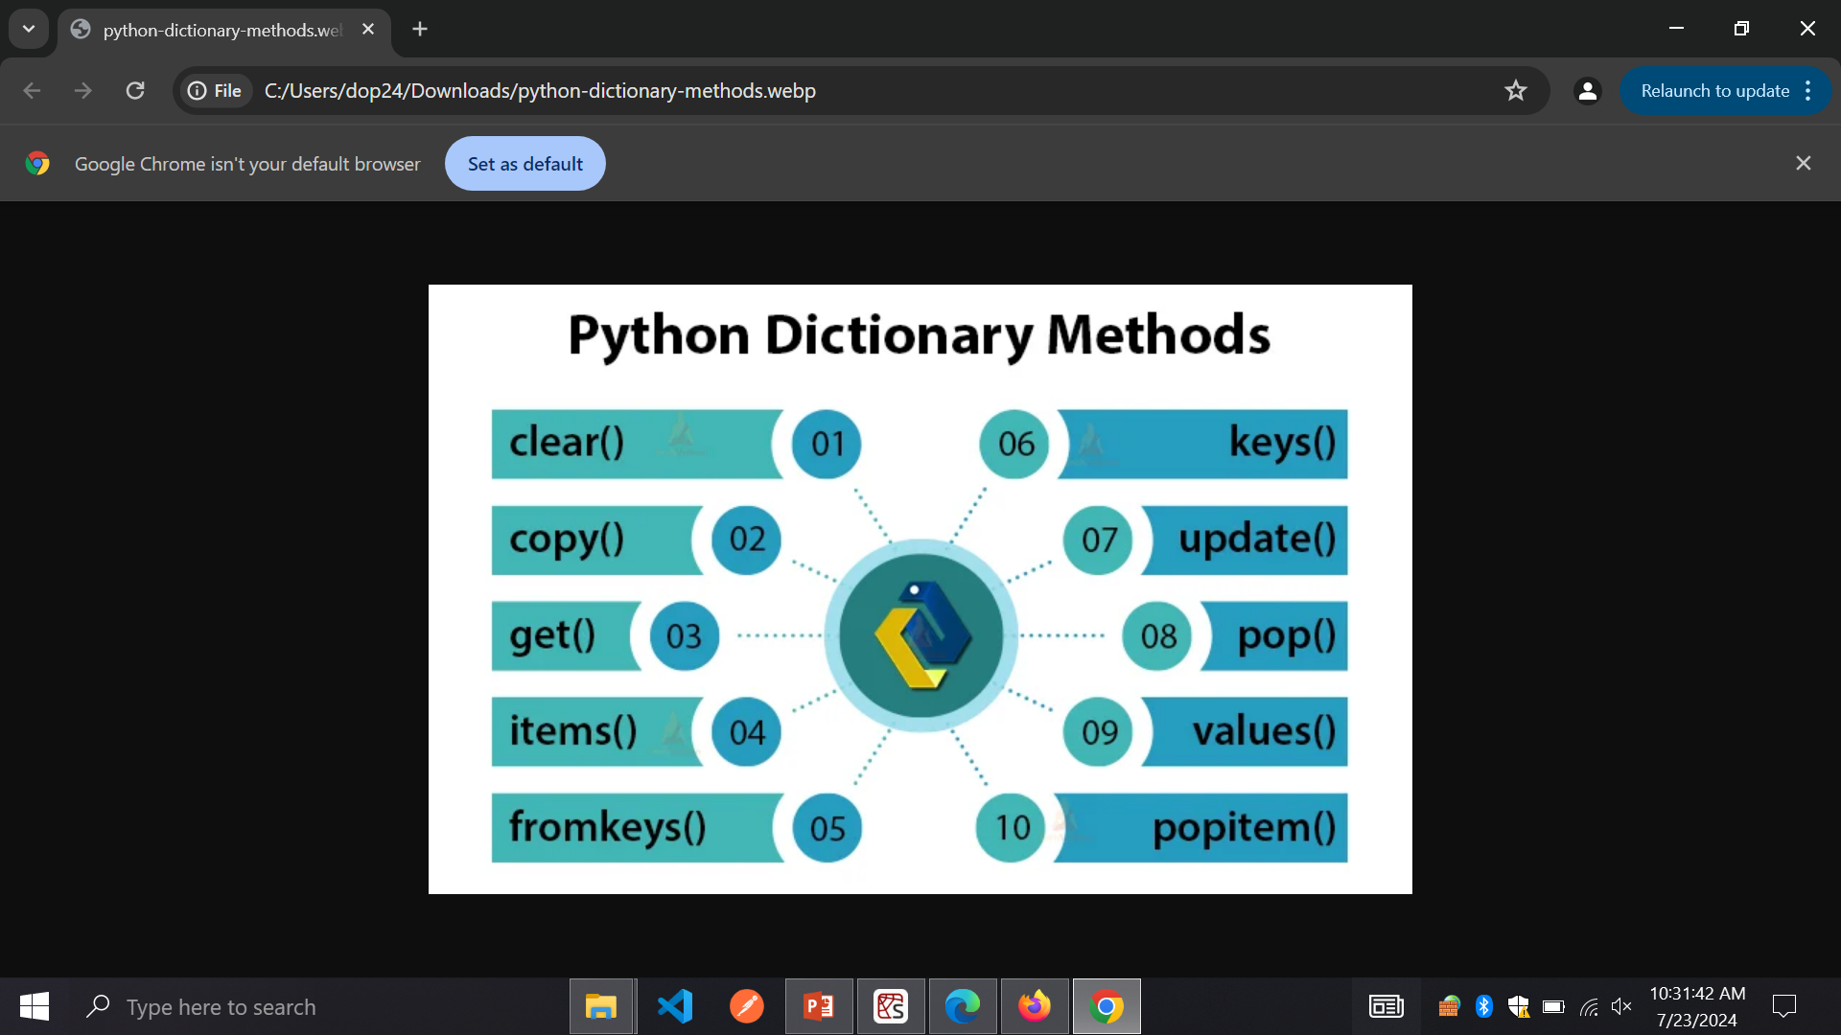
Dictionary Methods

Slide 10
LOOPS
Probably the most powerful thing about computers is that they can repeat things over and over very quickly.
There are several ways to repeat things in Python, the most common way of which is the for loop.

Slide 11
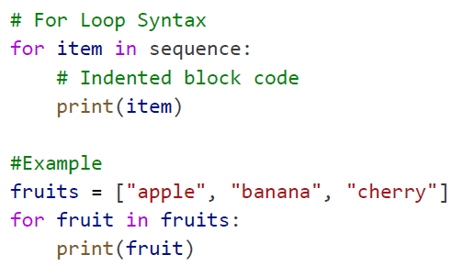
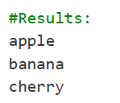
For loop…
For Loops:
Used for iterating over a sequence (e.g. list, tuple, string, or range).
Rules
Indentation must be consistent (typically 4 spaces per level).
Variable scope remains within the loop unless explicitly defined otherwise.

Slide 12
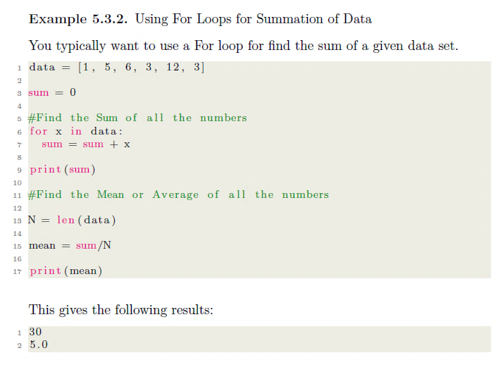
For Loops Cont…

Slide 13
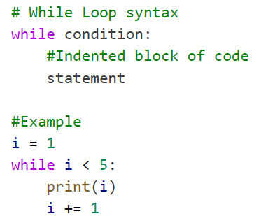
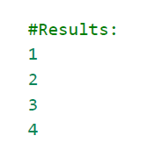
While Loops in Python
While Loops:
Executes a block of code repeatedly as long as a condition is true.
Rules
Indentation must be consistent
Variable scope remains within the loop unless explicitly defined otherwise.

Slide 14
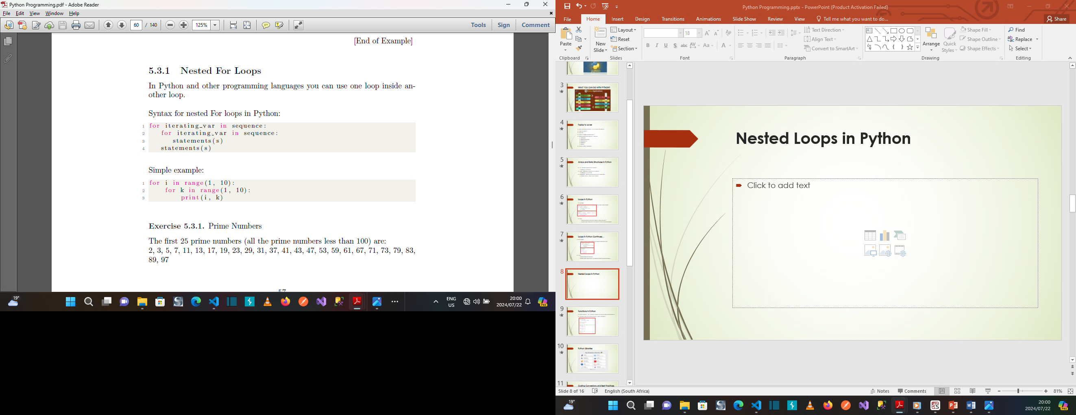
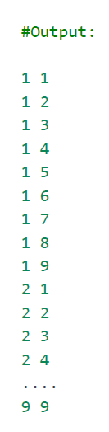
Nested Loops in Python

Slide 15

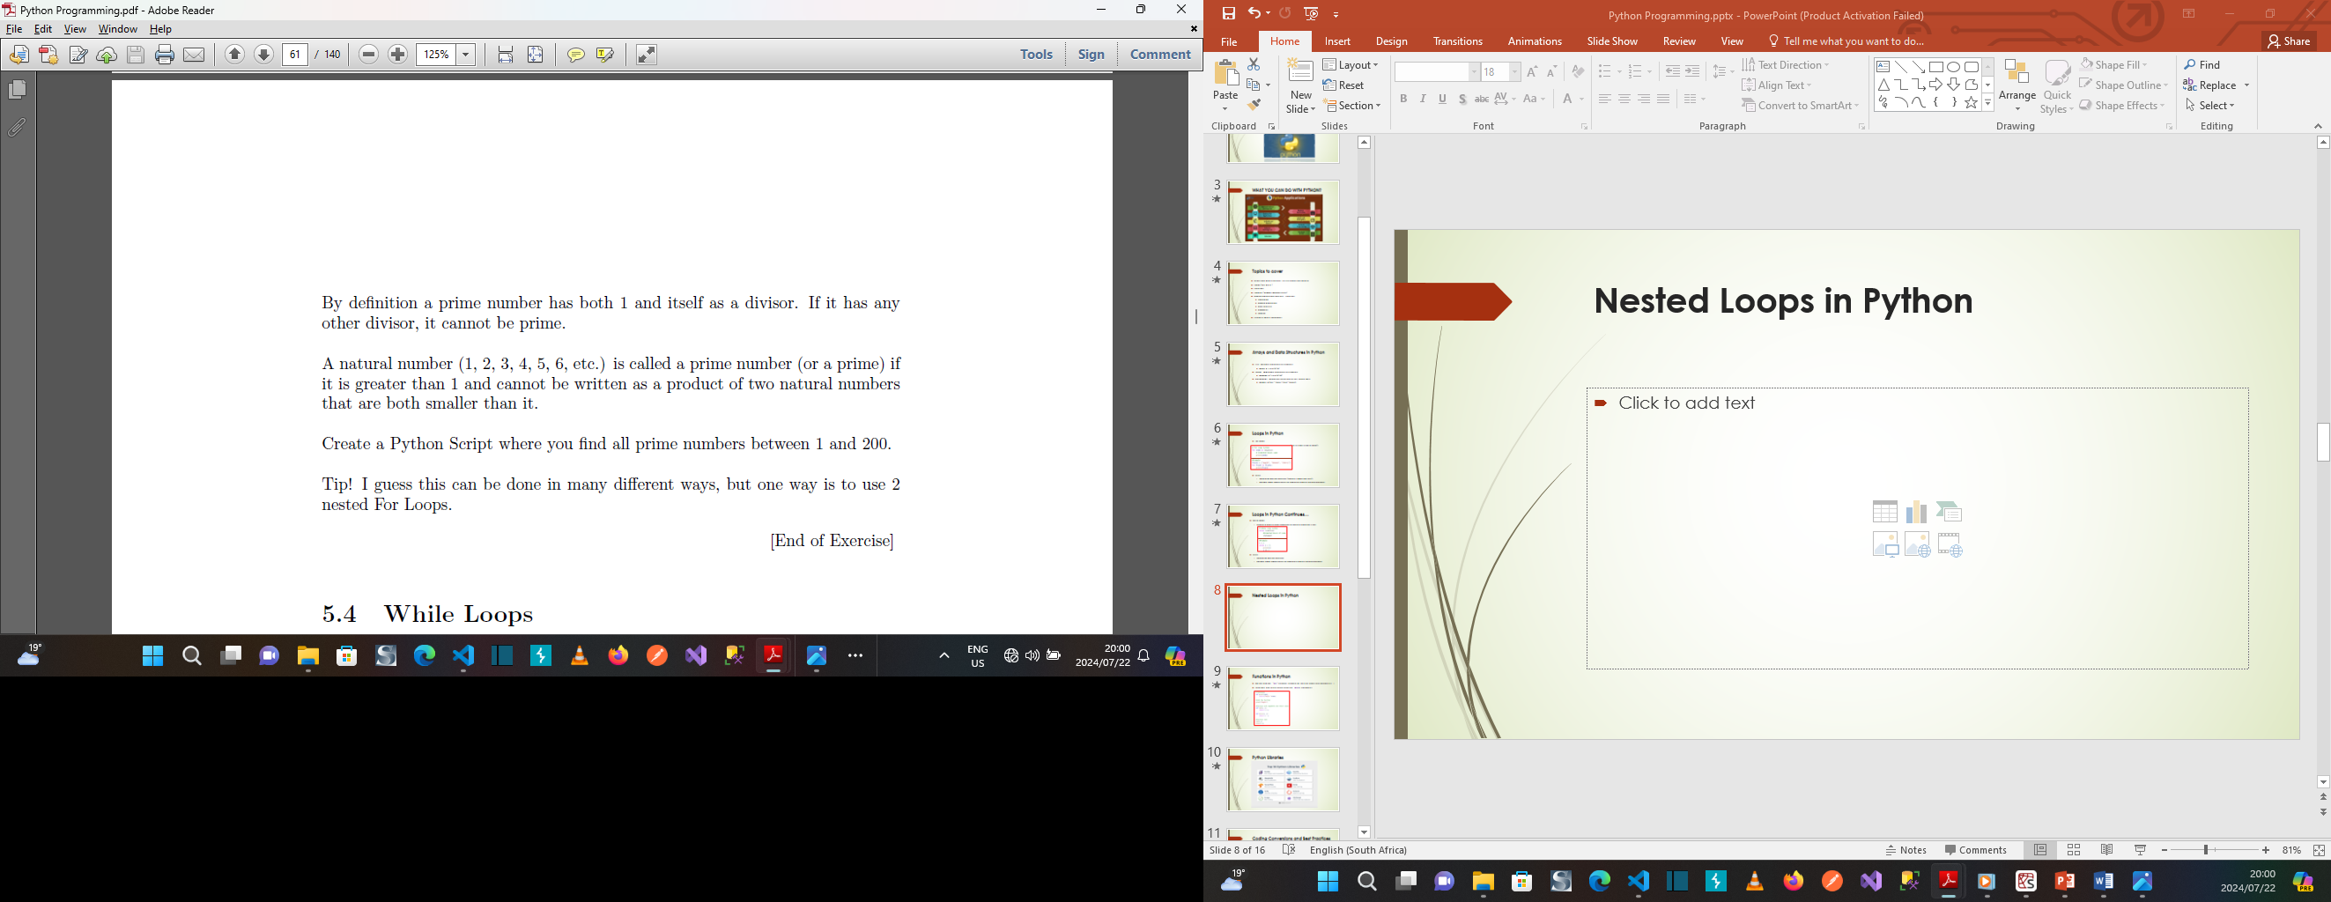
Exercise...

Slide 16
Functions
Functions are useful for breaking up a large program to make it easier to read and maintain.
They are also useful if you find yourself writing the same code at several different points in your program.
You can put that code in a function and call the function whenever you want to execute that code.
You can also use functions to create your own utilities, math functions,…

Slide 17
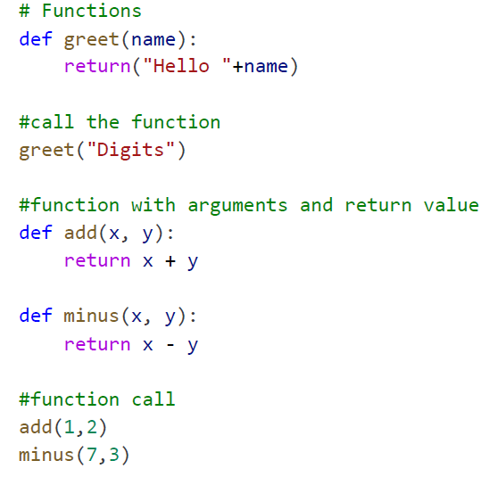
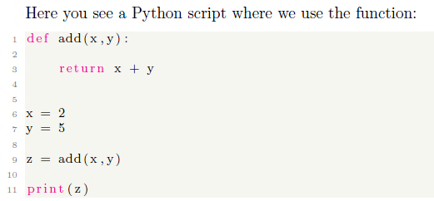
Functions in Python
Define Function: `def` keyword followed by function name and parameter(s).
Functions can return values using the return statement.

Slide 18
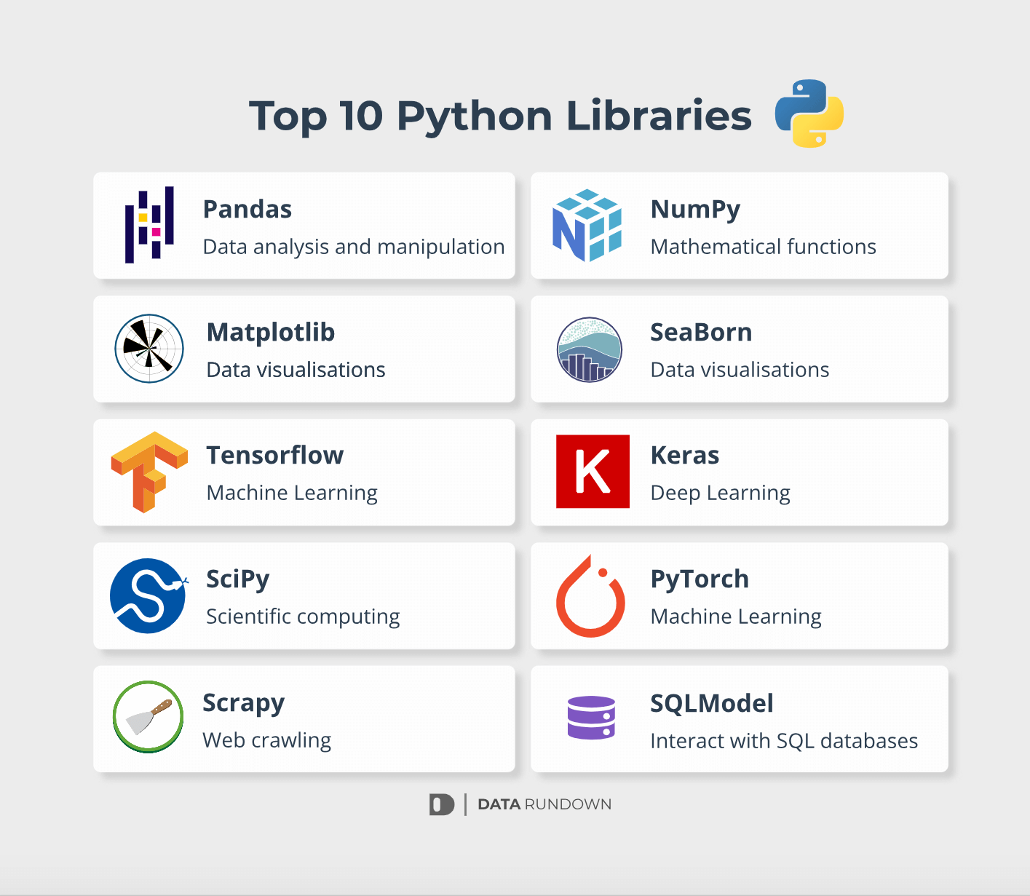
Famous Python Libraries

Slide 19
Coding Conversions and Best Practices
Indentation: Consistent use of 4 spaces per indentation level. Use Tab button on your Keyboard to indent python code.
Naming Conventions:
Variables: `lower_case_with_underscores`
Functions and methods: `lower_case_with_underscores`
Classes: `CapitalizedWords`
Case Sensitivity
Python is case-sensitive
`variable_name`, `Variable_Name`, and `VARIABLE_NAME` are treated as different variables

Slide 20
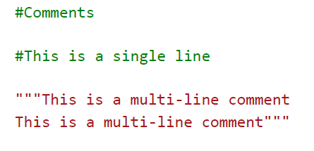
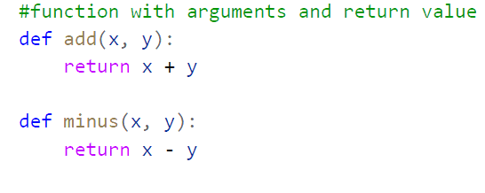
Continues…
Comments:
Used to explain code, provide context, and temporarily disable code.
Single-line comments start with `#`
Multi-line comments are enclosed in triple quotes `”””`
Spacing: Spaces around operators and after commas for readability.
`function(arg1,arg2)` instead of `function(arg1, arg2)`

Slide 21
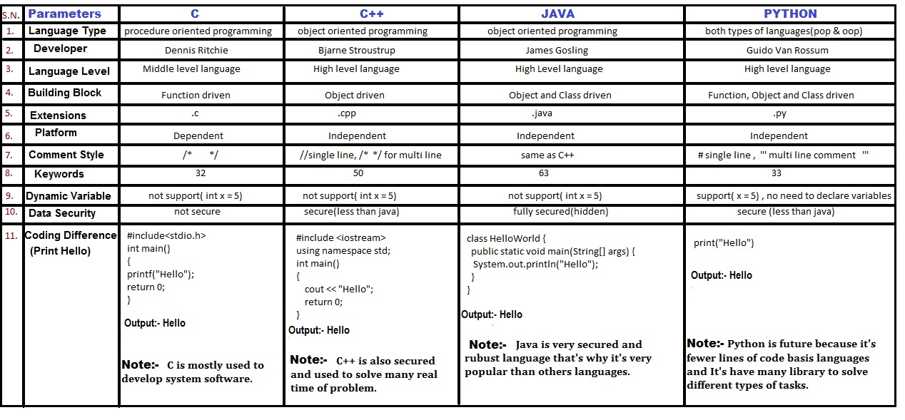
Python VS OTHER LANGUAGES
PYTHON
OTHER LANGUAGES

Slide 22
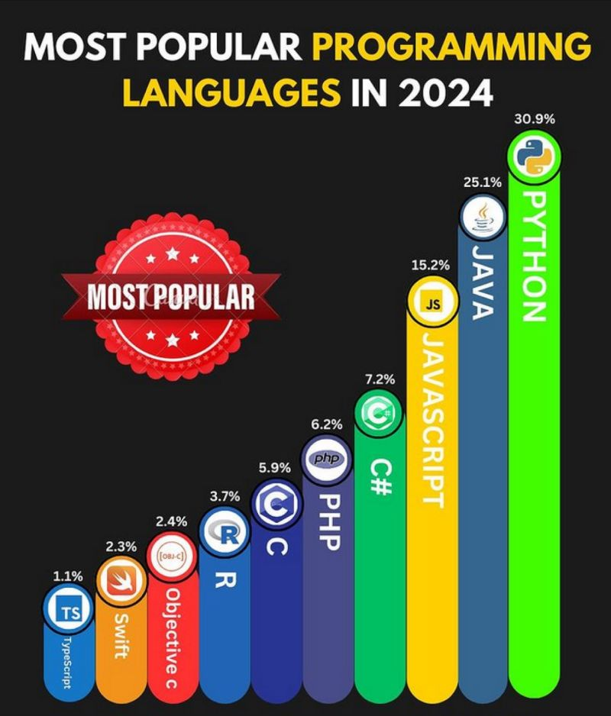
PYTHON VS OTHER PROGRAMMING LANGUAGES according to LinkedIn POLL

Slide 23
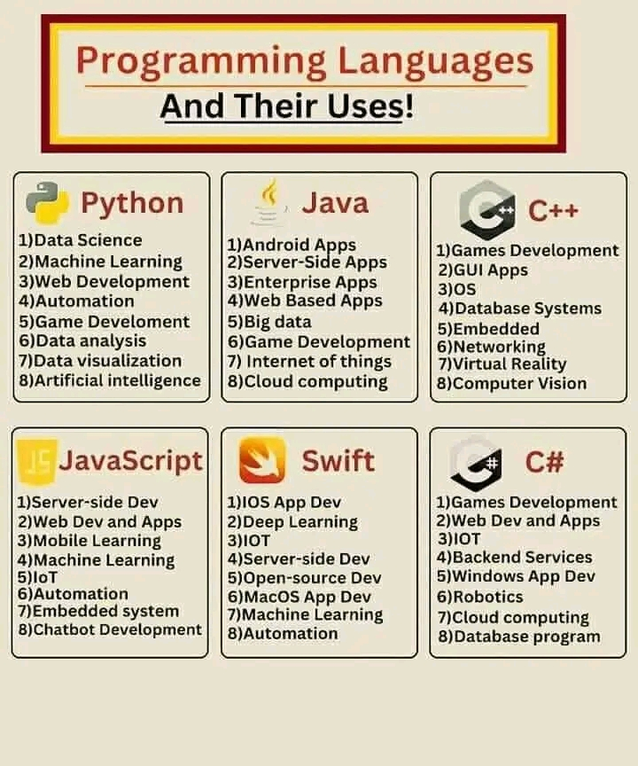
PROGRAMMING LANGUAGES

Slide 24
Racap
Python Applications (Web, Games, Business, Scientific, etc…)
Loops (for, while)
Nested Loop (loop within a loop)
General and Specific Data Structures(Arrays, Lists, Tuples,…)
Functions (def key word, parameter(s) and return statement)
Python Libraries(numpy, matplot, pandas,…)
Coding Conversions and Best Practices (Case-sensitivity, Indentation,…)
Python vs Other Programming Languages

Slide 25
Conclusion
Python's versatility and simplicity make it a preferred language for various applications.
Understanding loops, arrays, functions, and adhering to syntax rules ensures efficient and maintainable code.
Python is a great choice if you're a beginner who wants to learn a language that you can then use to build real-world applications.

Slide 26
Thank You For Your Attention!
☺

